Slide 1

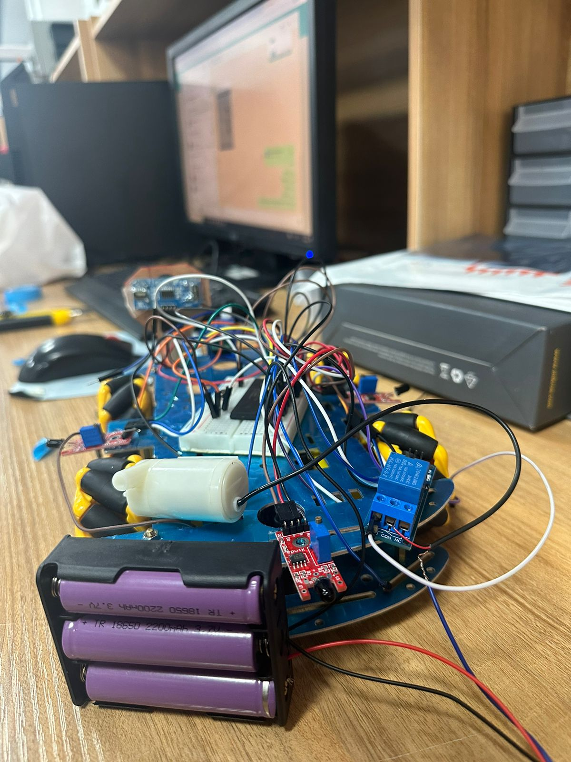
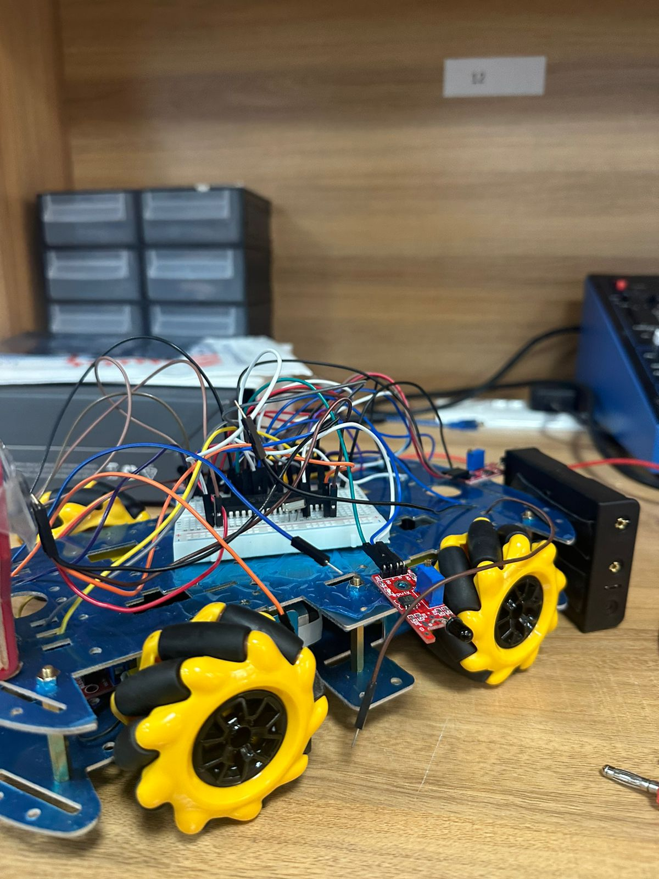
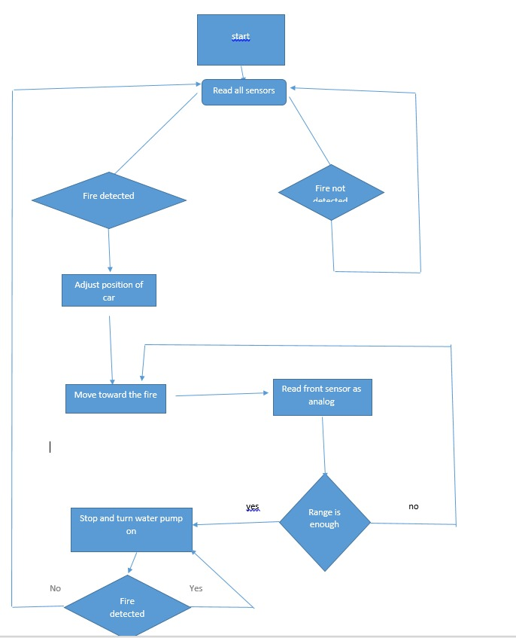
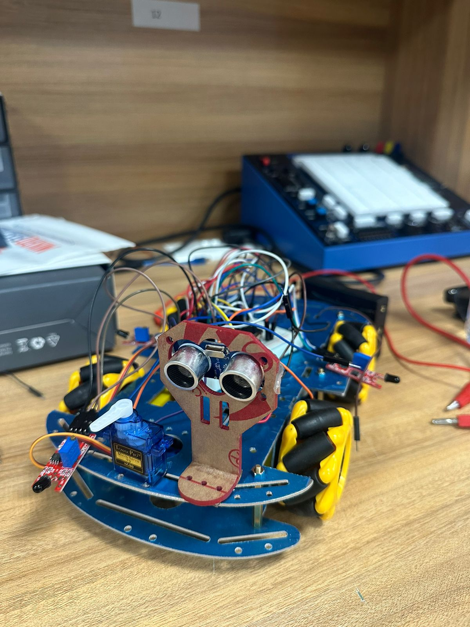
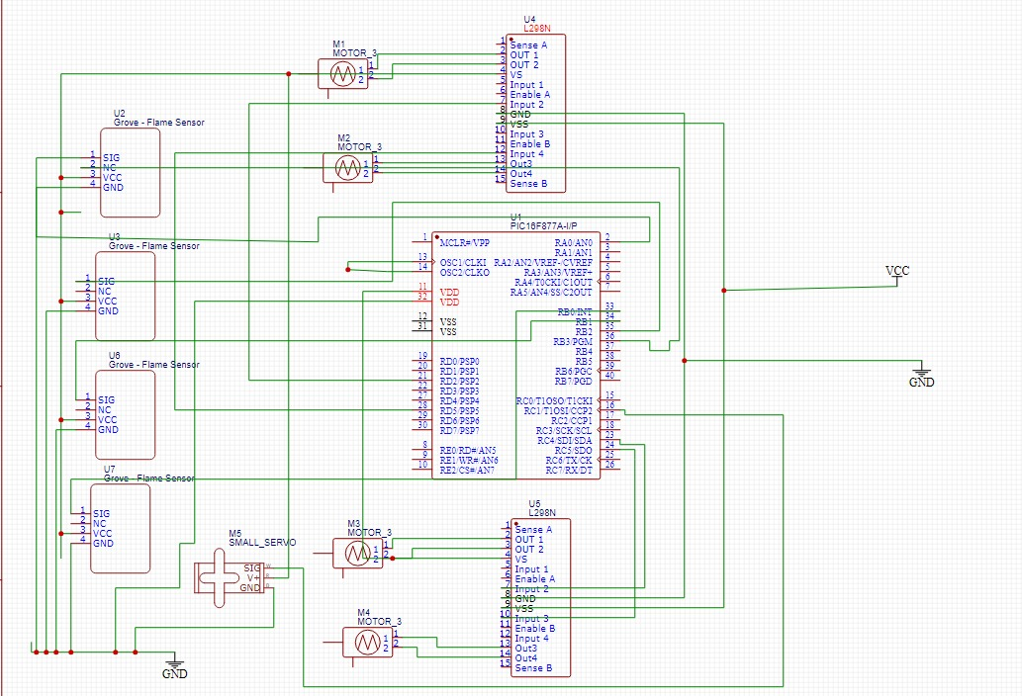
Firefighting robot
Abdallah Juma, Motasem Amaireh, Almuthanna Alawwad
Supervisor: Dr. Belal Sababha
Embedded Systems Final Design Project, Spring 2024
King Abdullah II School of Engineering
Princess Sumaya University for Technology
Introduction
This firefighting robot’s objectives are to travel straight when facing a fire, steer freely in the direction of any detected fire, and precisely spray water when it gets near to the fire. The servo motor controls the hose. An ultrasonic sensor to avoid running into objects when moving straight ahead. Effective and cautious responses to a variety of firefighting circumstances are ensured by the integrated architecture. There are four flame sensors in the smart firetruck. Three 3.7V batteries, a PIC 16F877A microprocessor, an ultrasonic sensor, and a water system comprising a tank, pump, and servo motor.
Results
The following figures show firefighter robot.
Figure 4: firetruck one.
Figure 5: firetruck two.
.
Figure 6: firetruck three.
Sensors connected to the microchip detects the fire so that the firetruck can get close to the fire to be able to put it out using the water tank and servo motor that moves the pumper left and right to increase the covered distance by the pumped water.
Design
To detect the presence of a fire readings from all sensors are taken and analyzed by the microchip PIC16F877A. In the case a fire is detected the fire truck moves in the directions of the fire and water from the attached water tank is sprayed continuously until the fire is no longer detected.
Figure 1 shows the design of the fire truck behavior.
Figure 1: Design.
Figure 2 Electrical scheme.
Conclusion
Overall, the PIC 16F877A MCU we used for our fireman robot project allows it to detect and react to flames. The robot navigates effectively by combining digital and analog flame sensors with precision motor control. The project showcases a straightforward but efficient method and demonstrates the usefulness of automation in firefighting circumstances.

